Slide 1
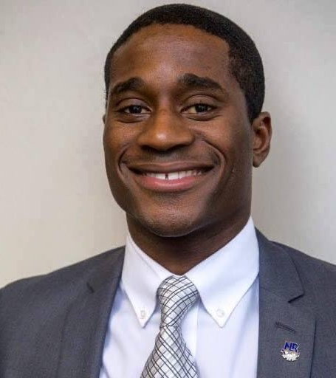
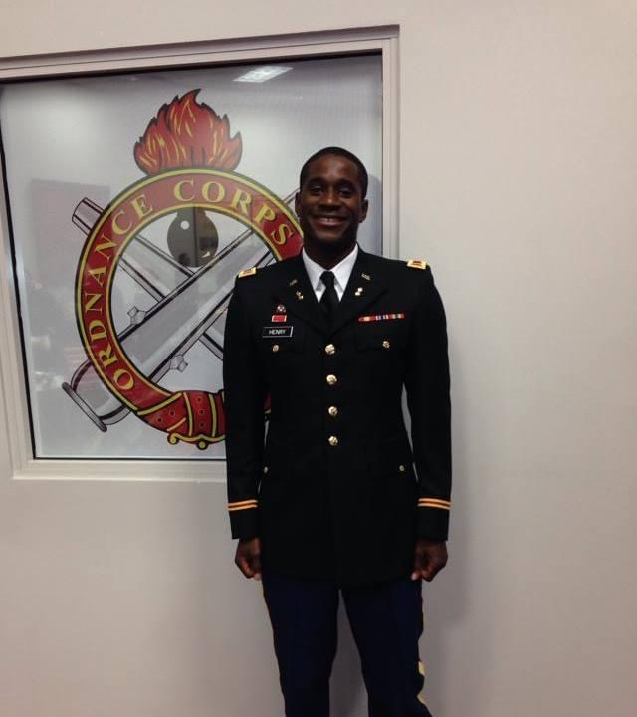
Isaac Henry Bio

Slide 2
Community Involvement
PAL (Police Athletic League) Coach and Board Member 9 Years
Big Brother for Big Brothers Big Sisters Central Arkansas
Arkansas Youth Challenge Mentor
North Little Rock School District Wildcat Foundation Board Member
North Little Rock Boys and Girls Club Coach for 15 years
North Little Rock NAACP Member
UAPB Alumni Association Member
Co-Founder of NLR WORKS. Teen Program for the City of North Little Rock

Slide 3
Professional Portfolio
Special Assistant to the Mayor of North Little Rock
Health and Wellness Director for the City of North Little Rock
Community Garden Director of 28 plus gardens
Athletic Director/Assistant Director of North Little Rock Boys and Girls Club
Middle School Health and PE Teacher
High School Health, English and Special Education Teacher
Arkansas State House of Representatives Candidate
DEI Facilitator for the City of North Little Rock
NLR WORKS Youth Program Co-Founder
Head Middle School Football and Basketball Coach
High School Football Coach

Slide 4

Professional Organizations
North Little Rock NAACP
Democratic Party of Arkansas
Omega Psi Phi Fraternity Incorporated
North Little Rock Police Athletic League Board
North Little Rock School District Wildcat Foundation Board
US Army Black Officers Association
University of Arkansas Pine Bluff Alumni Association
Army Ordnance Officer Association

